Slide 1









ResumeRole Finder
Ch. Arjun Reddy
G. Sathwika
B .Saketh Reddy
MD. Arshad
VExplorers

Slide 2


Problem Statement
The current job search process can be inefficient for applicants, often leading to difficulty in identifying roles that truly match their skills and experience. This mismatch can result in wasted time and effort for both job seekers and employers

Slide 3






Solution
We present a resume recommendation system designed to bridge the gap between applicant skills and relevant job opportunities. This system leverages technology to streamline the job search process for both applicants and employers.

Slide 4
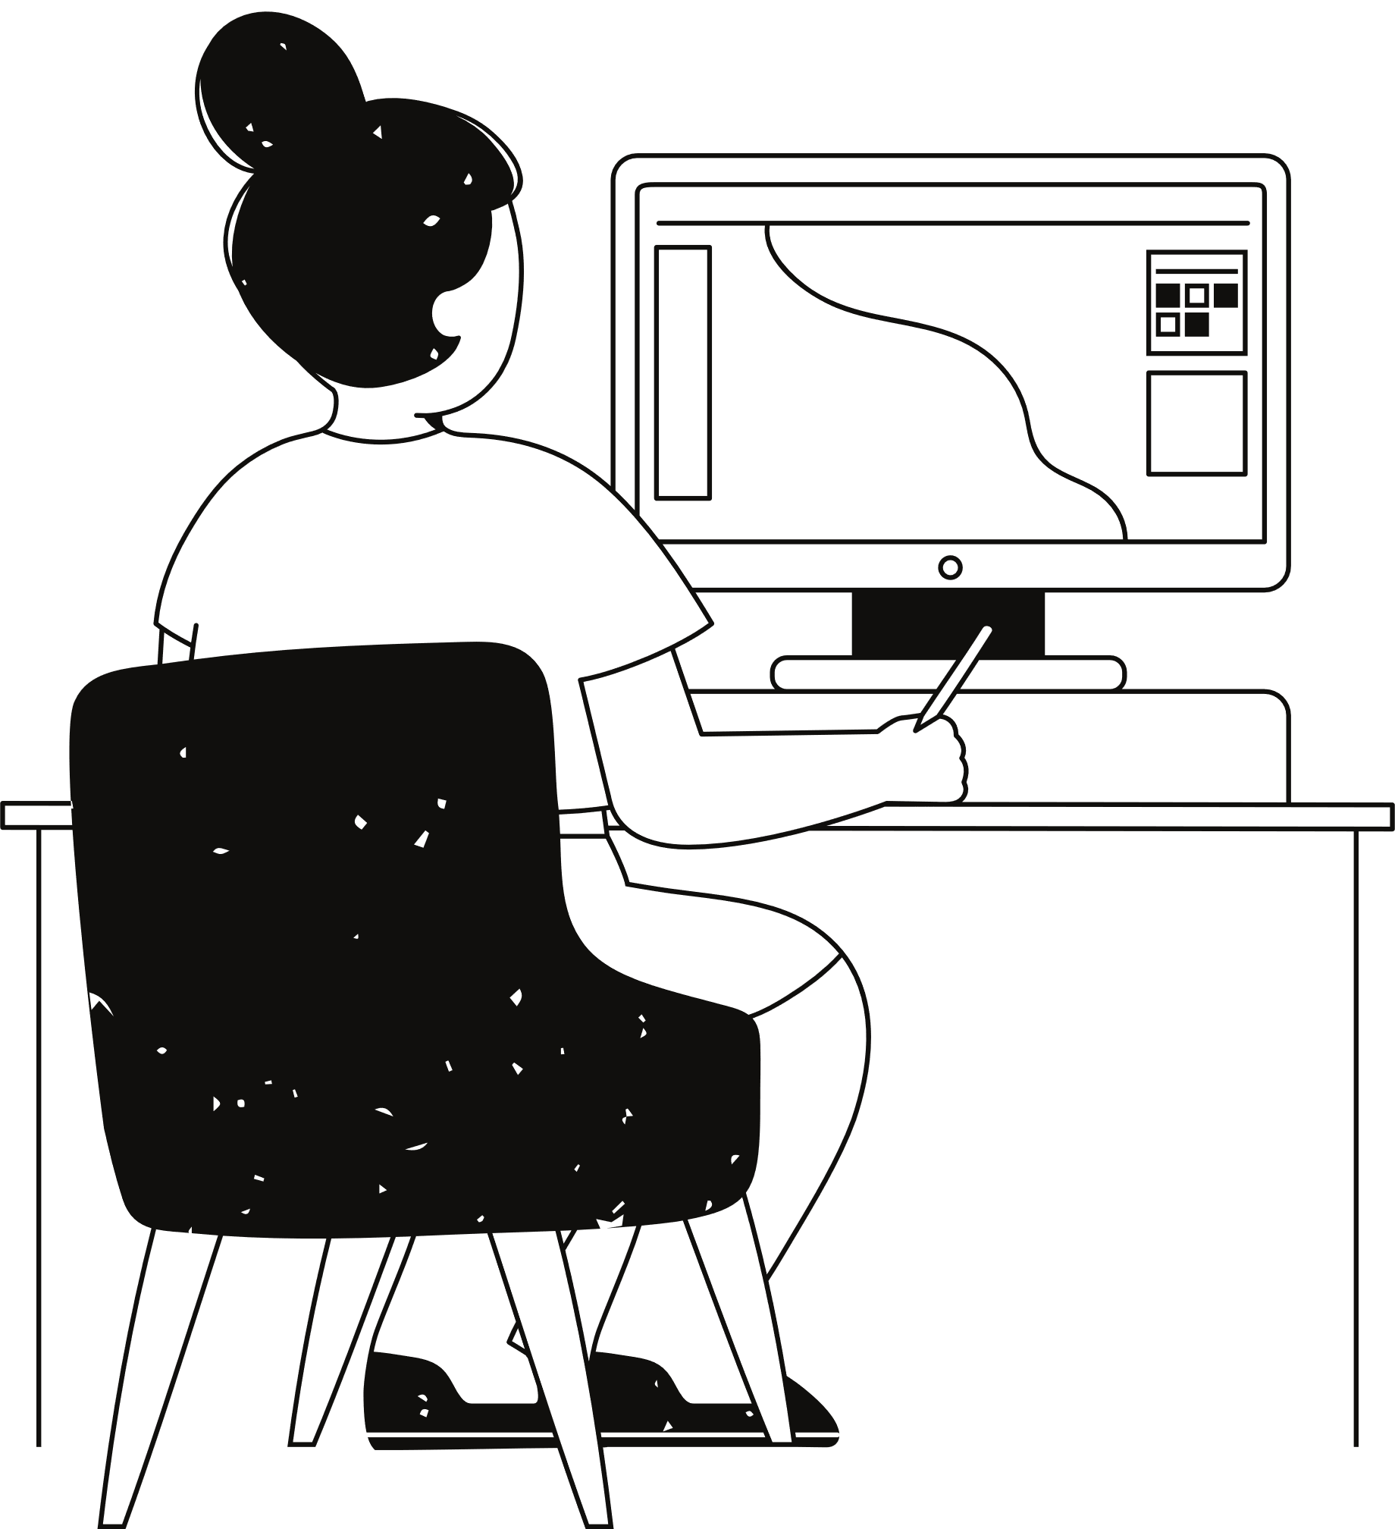
Introduction
Briefly introduce the challenges of navigating the job market, particularly identifying suitable roles.
Highlight the growing importance of skills-based hiring and the need for efficient job matching.
Introduce your project as a solution: a resume recommendation system that leverages technology to analyze skills and suggest relevant job categories.

Slide 5



Abstract
This project presents a web application designed to analyze resumes and suggest suitable job roles for applicants.
The application leverages Natural Language Processing (NLP) techniques to extract skills and experience from uploaded resumes.
These extracted features are then used by a machine learning model to predict the most relevant job category for the applicant's profile.

Slide 6
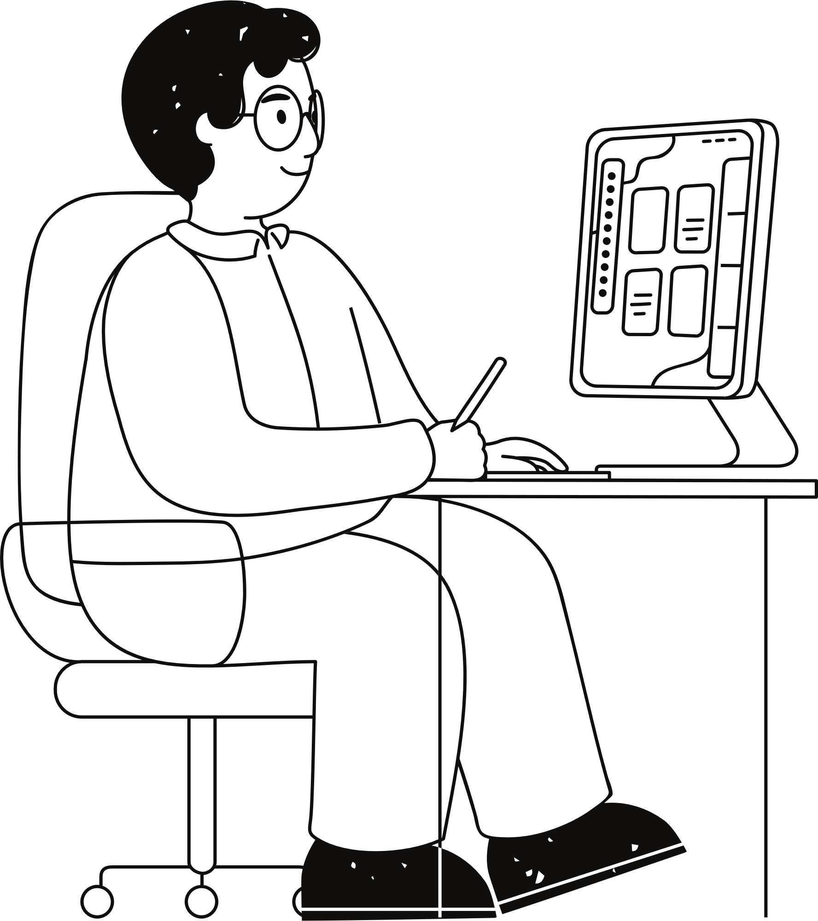

Implementation
Preprocessing: Clean resumes (PDF/text) for analysis (remove irrelevant info).
Skill Extraction: Identify skills & experience keywords.
Feature Engineering: Prepare extracted data for the model.
Prediction: Use a pre-trained model to predict job categories.
Mapping: Translate predictions to human-readable job categories.

Slide 7






Ideation process
01
02
03
04
Job seekers struggle to target suitable roles.
Bridge the gap between skills and opportunities using NLP & Machine Learning to analyze resumes and recommend job categories.
User uploads resume (text/pdf). System extracts skills, predicts job category using a pre-trained model, and recommends it.
Assess resources (data, libraries, expertise), impact (job seekers & employers), and value proposition.

Slide 8
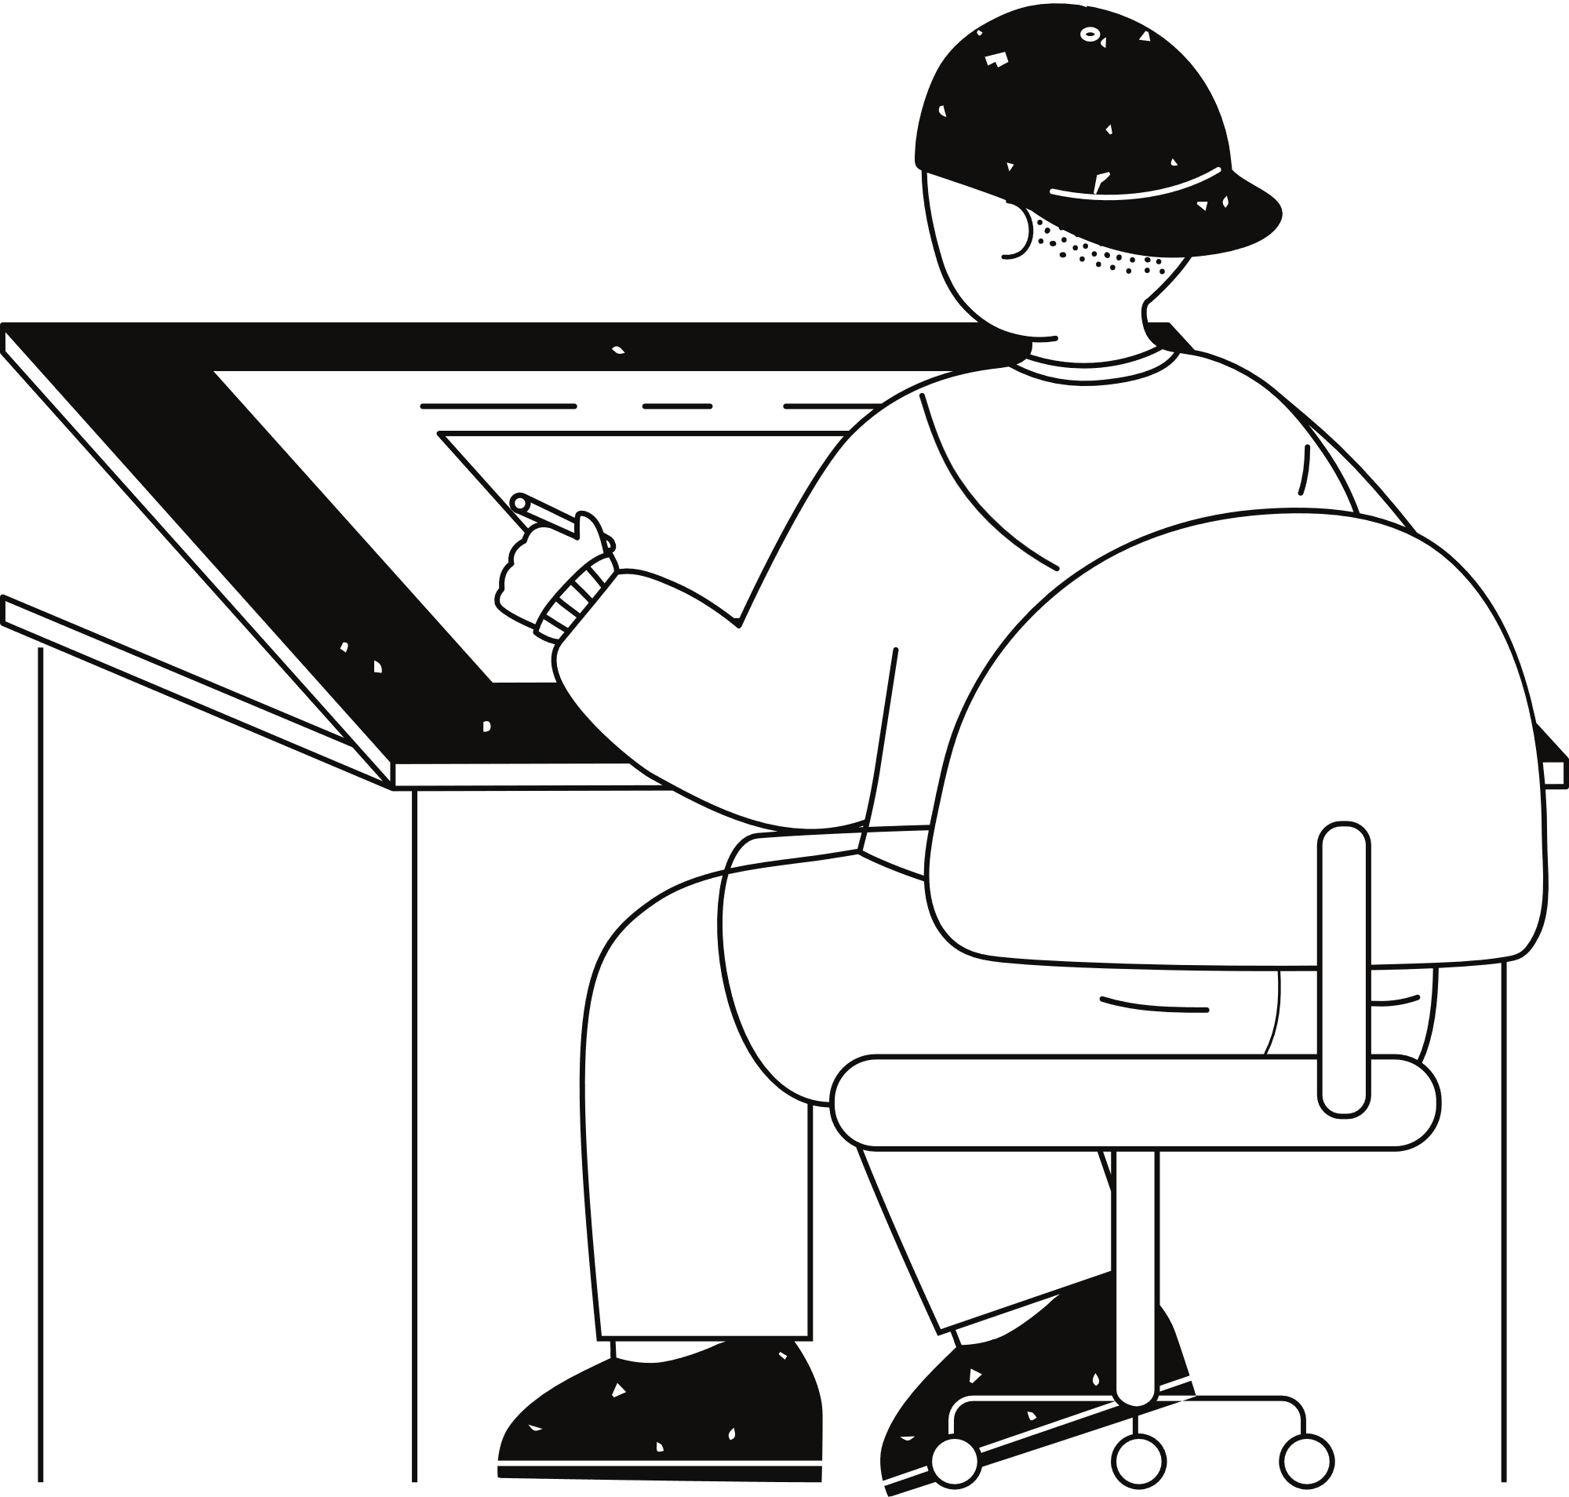




User Input
Analysis
Mind map
Processing
Prediction
Skill &
Experience Extraction
Recommend

Slide 9
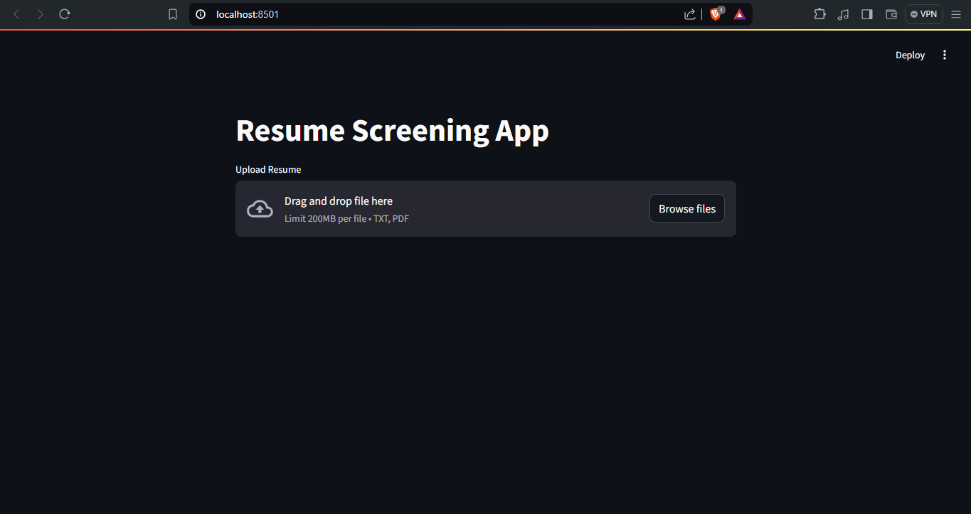
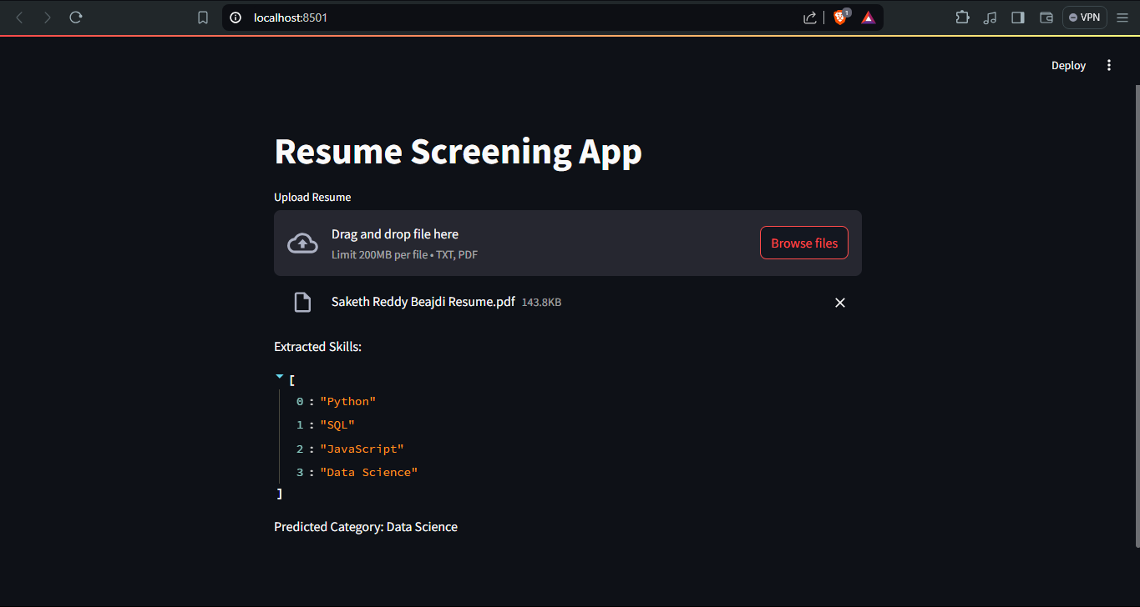
Prototype

Slide 10

Expanding Possibilities
01.
Personalized Recommendations
02.
Multilingual Support
03.
Job
Board Integration
04.
Skill Gap Analysis

Slide 11



Thank you very much!

